Slide 1
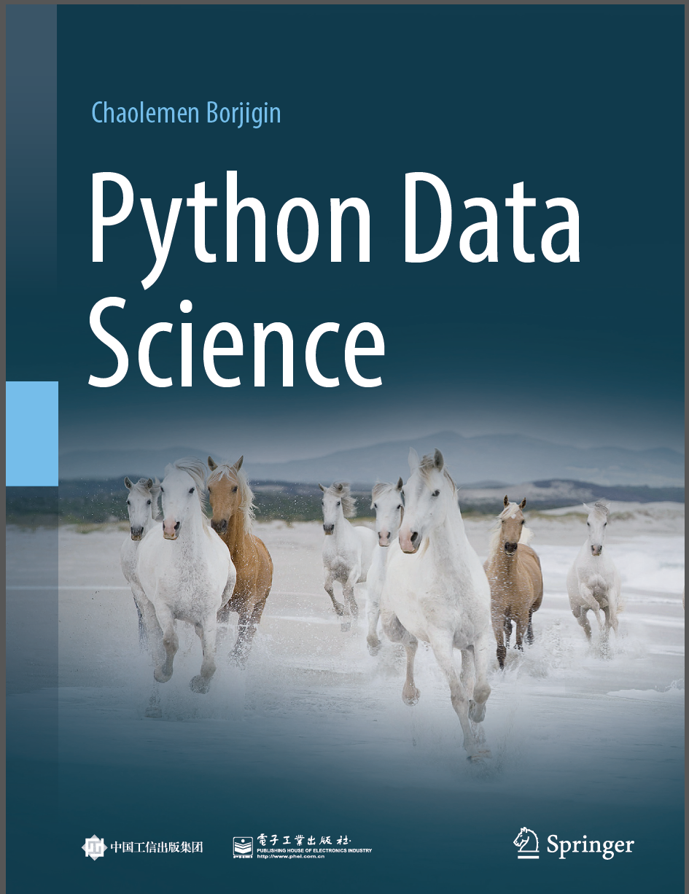
Python Programming —— From Data Analysis to Data Science
Chaolemen Borjigin
Renmin University of China
chaolemen@ruc.edu.cn

Slide 2
4.5 Date and time
Chaolemen Borjigin
Renmin University of China
chaolemen@ruc.edu.cn

Slide 3
Summary of this chapter
▼Chapter 4 Data processing
► 4.5 Date and time
4.5.1 Creating a time or date object
4.5.2 Parsing a string to a time or date object
4.5.6 The pandas.period_range() method
4.5.4 Evaluating the difference between two date or time objects
4.5.5 Setting a time or date object as the index of Pandas
4.5.3 Getting current local data or time object

Slide 4
4.5.1 Creating a time or date object
▼Chapter 4 Data processing
► 4.5 Date and time
In[2]:
import datetime as dt
myTime = dt.time(12,34,59)
print("myTime:",myTime)
print("myTime.hour:",myTime.hour)
print("myTime.minute:",myTime.minute)
print("myTime.second:",myTime.second)
myTime: 12:34:59
myTime.hour: 12
myTime.minute: 34
myTime.second: 59

Slide 5
4.5.1 Creating a time or date object
▼Chapter 4 Data processing
► 4.5 Date and time
In[3]:
dt.datetime(year = 2018,month = 3,day = 3)
Out[3]:
datetime.datetime(2018, 3, 3, 0, 0)
In[4]:
dt.datetime?
# Init signature: dt.datetime(self, /, *args, **kwargs)
# Docstring:
# datetime(year, month, day[, hour[, minute[, second[, microsecond[,tzinfo]]]]])
……
# Type: type

Slide 6
4.5.1 Creating a time or date object
▼Chapter 4 Data processing
► 4.5 Date and time
In[5]:
dt.datetime(month=3,day=3,second=59)
---------------------------------------------------------------------------
TypeError Traceback (most recent call last)
<ipython-input-5-6fbb4e101d77> in <module>()
----> 1 dt.datetime(month=3,day=3,second=59)
TypeError: Required argument 'year' (pos 1) not found
In[6]:
dt.datetime(year=2018,month=3,day=3,second=59)
Out[6]:
datetime.datetime(2018, 3, 3, 0, 0, 59)

Slide 7
4.5.2 Parsing a string to a time or date object
▼Chapter 4 Data processing
► 4.5 Date and time
In[8]:
dt.datetime("3th of July,2018")
---------------------------------------------------------------------------
TypeError Traceback (most recent call last)
<ipython-input-8-c7659db11b43> in <module>()
----> 1 dt.datetime("3th of July,2018")
TypeError: an integer is required (got type str)
In[9]:
dt.datetime("2019-1-3")
---------------------------------------------------------------------------
TypeError Traceback (most recent call last)
<ipython-input-9-c1b53c571977> in <module>()
----> 1 dt.datetime("2019-1-3")
TypeError: an integer is required (got type str)

Slide 8
4.5.2 Parsing a string to a time or date object
▼Chapter 4 Data processing
► 4.5 Date and time
In[10]:
from dateutil import parser
date= parser.parse("3th of July,2018")
print(date)
2018-07-03 00:00:00
date= parser.parse("2019-1-3")
print(date)
In[11]:
2019-01-03 00:00:00

Slide 9
4.5.2 Parsing a string to a time or date object
▼Chapter 4 Data processing
► 4.5 Date and time
In[12]:
import pandas as pd
pd.to_datetime("3th of July,2018")
Out[12]:
Timestamp('2018-07-03 00:00:00')
import pandas as pd
pd.to_datetime("2019-1-3")
In[13]:
Timestamp('2019-01-03 00:00:00')
Out[13]:

Slide 10
4.5.3 Getting current local data or time object
▼Chapter 4 Data processing
► 4.5 Date and time
In[14]:
dt.datetime.now()
Out[14]:
datetime.datetime(2018, 5, 24, 21, 39, 50, 155634)
In[15]:
dt.datetime.today()
datetime.datetime(2018, 5, 24, 21, 39, 50, 913872)
Out[15]:
In[16]:
now=dt.datetime.now()
now.strftime("%W"),now.strftime("%a"),now.strftime("%A"),now.strftime("%B"),now.strftime("%C"),now.strftime("%D")
Out[16]:
('51', 'Sun', 'Sunday', 'December', '20', '12/23/18')

Slide 11
4.5.4 Evaluating the difference between two date or time objects
▼Chapter 4 Data processing
► 4.5 Date and time
In[17]:
d1=dt.datetime.now()
d2=dt.datetime(year=2017,month=3,day=3)
(d1-d2).days
Out[17]:
447

Slide 12
4.5.5 Setting a time or date object as the index of Pandas
▼Chapter 4 Data processing
► 4.5 Date and time
In[18]:
index=pd.DatetimeIndex(["2018-1-1","2019-1-2","2018-1-3","2018-1-4","2018-1-5"])
data=pd.Series([1,2,3,4,5],index=index)
data
Out[18]:
2018-01-01 1
2019-01-02 2
2018-01-03 3
2018-01-04 4
2018-01-05 5
dtype: int64

Slide 13
4.5.5 Setting a time or date object as the index of Pandas
▼Chapter 4 Data processing
► 4.5 Date and time
In[19]:
data["2018-1-2"]
Out[19]:
Series([], dtype: int64)
In[20]:
data["2018"]
2018-01-01 1
2018-01-03 3
2018-01-04 4
2018-01-05 5
dtype: int64
Out[20]:

Slide 14
4.5.5 Setting a time or date object as the index of Pandas
▼Chapter 4 Data processing
► 4.5 Date and time
In[21]:
data- data["2018-1-4"]
Out[21]:
2018-01-01 NaN
2018-01-03 NaN
2018-01-04 0.0
2018-01-05 NaN
2019-01-02 NaN
dtype: float64

Slide 15
4.5.5 Setting a time or date object as the index of Pandas
▼Chapter 4 Data processing
► 4.5 Date and time
In[22]:
data
Out[22]:
2018-01-01 1
2019-01-02 2
2018-01-03 3
2018-01-04 4
2018-01-05 5
dtype: int64

Slide 16
4.5.5 Setting a time or date object as the index of Pandas
▼Chapter 4 Data processing
► 4.5 Date and time
In[23]:
data.to_period(freq="D")
Out[23]:
2018-01-01 1
2019-01-02 2
2018-01-03 3
2018-01-04 4
2018-01-05 5
Freq: D, dtype: int64

Slide 17
4.5.5 Setting a time or date object as the index of Pandas
▼Chapter 4 Data processing
► 4.5 Date and time
In[24]:
data.to_period(freq="M")
Out[24]:
2018-01 1
2019-01 2
2018-01 3
2018-01 4
2018-01 5
Freq: M, dtype: int64

Slide 18
4.5.5 Setting a time or date object as the index of Pandas
▼Chapter 4 Data processing
► 4.5 Date and time
In[25]:
data- data[3]
Out[25]:
2018-01-01 -3
2019-01-02 -2
2018-01-03 -1
2018-01-04 0
2018-01-05 1
dtype: int64

Slide 19
4.5.5 Setting a time or date object as the index of Pandas
▼Chapter 4 Data processing
► 4.5 Date and time
In[26]:
data- data["20180104"]
Out[26]:
2018-01-01 NaN
2018-01-03 NaN
2018-01-04 0.0
2018-01-05 NaN
2019-01-02 NaN
dtype: float64

Slide 20
4.5.6 The pandas.period_range() method
▼Chapter 4 Data processing
► 4.5 Date and time
In[27]:
pd.period_range("2019-1",periods=10, freq="D")
Out[27]:
PeriodIndex(['2019-01-01', '2019-01-02', '2019-01-03', '2019-01-04', '2019-01-05', '2019-01-06', '2019-01-07', '2019-01-08',
'2019-01-09', '2019-01-10'], dtype='period[D]', freq='D')
In[28]:
pd.period_range("2019-1",periods=10, freq="M")
Out[28]:
PeriodIndex(['2019-01', '2019-02', '2019-03', '2019-04', '2019-05', '2019-06', '2019-07', '2019-08', '2019-09', '2019-10'], dtype='period[M]', freq='M')

Slide 21


